Slide 1
Presentation on Report project Name : Most used beauty & cosmetics products
Prepared By : Rutuja Harer
Guide By: Vishal Sir

Slide 2
Content
Introduction
Problem statement
Key findings
Objective
Methodology
Key findings
Conclusion
Recommendation

Slide 3
INTRODUCTION
This dataset contains information about a diverse range of beauty products from various brands. Key attributes include product name, brand, category, usage frequency, price, customer rating, number of reviews, and product size.
The dataset also provides details on skin type, target gender, packaging type, main ingredients, whether the product is cruelty-free, and its country of origin.
The dataset consists of 15000 rows and 14 columns, capturing various details about beauty & Cosmetics products.

Slide 4
Problem statement
The problem statement is to analyze product performance based on factors like price, ratings, and ingredients, while identifying key trends in customer preferences across different cosmetic categories.

Slide 5
Key insights
1. what is the uses frequency for top 3 brands and have 3.1 ratings?
Usage_Frequency | Brand | Total Count
Occasional | Milk Makeup | 55
Monthly | Milk Makeup | 65
Weekly | Milk Makeup | 0
daily | Milk Makeup | 52
Occasional | Make Up For Ever | 60
Monthly | Make Up For Ever | 53
Weekly | Make Up For Ever | 50
Daily | Make Up For Ever | 47
Occasional | Kiehl‘s | 54
Monthly | Kiehl’s | 48
Weekly | Kiehl’s | 38
Daily | Kiehl’s | 55

Slide 6
Super Setting Spray
which is the top 5 most selling brand and there top 5 selling products?
Milk Makeup
Make up for Ever
Kiehl’s
NARS
E.L.F
Super concealer
S Setting spray
Magic lip liner
Ultra foundation
Divine mascara
Divine Exfoliator
Magic Concealer
Perfect Eyeshadow
Super BB Cream
Divine Blush
Super lip linear
Perfect Eye shadow
Perfect primer
Magic face oil
Perfect Mascara
Ultra lipstick
Super lipstick
Super Highlighter
Magic cleanser
Magic lip linear
Ultra face Mask
Magic Face oil
Magic setting spray
Perfect face Mask
Magic M remover

Slide 7
Top 5 brand suit on which skin type and there gender?
Brand | Skin_Types | Gender | Total counts
Milk Makeup | Dry | Female | 26
Milk Makeup | Combination | Female | 37
Milk Makeup | Oil | Female | 34
Milk Makeup | Sensitive | Female | 27
Milk Makeup | Normal | Female | 24
Milk makeup | Dry | Male | 0
Make up for ever | Oil | Male | 0
Kiehl’s | Sensitive | Male | 0

Slide 8
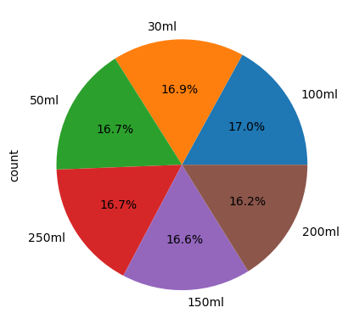
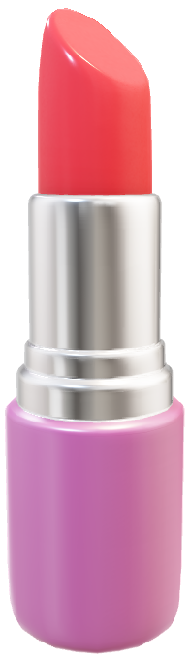
which product size sales most what are there number of reviews and ratings?
Product Size pie chart
587

Slide 9
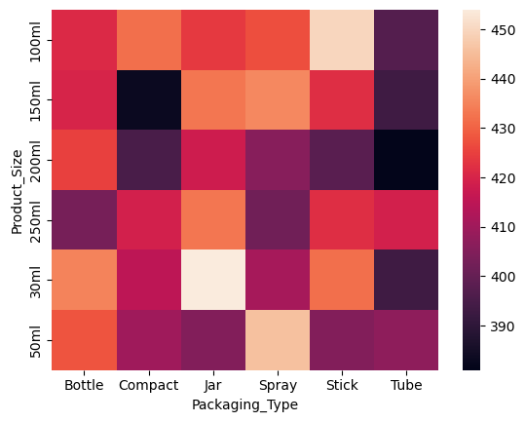
Which Product size sell most & what are there packing type?
Heat map
Table
Packaging_Type | Bottle | Compact | Jar | Spray | Stick | Tube
Product_Size
100ml | 421 | 432 | 424 | 427 | 450 | 397
150ml | 420 | 383 | 433 | 436 | 422 | 393
200ml | 425 | 395 | 418 | 406 | 398 | 381
250ml | 403 | 419 | 433 | 402 | 422 | 419
30ml | 435 | 415 | 454 | 411 | 432 | 393
50ml | 428 | 410 | 405 | 446 | 405 | 407

Slide 10
which type 5 product used by male and there packing type and what are the main ingredients in that?
Products
Ingredients
Retinol= 2180
Glycerin= 2174
Vitamin C= 2168
Salicylic Acid= 2149
Shea Butter= 2148
Aloe Vera= 2091
Hyaluronic Acid= 2090
Divine BB Cream
Divine Blush
Divine Bronzer
Divine CC Cream
Divine Cleanser
Packing_Type
Spray
Stick
Jar
Stick
Stick

Slide 11
Main_Ingredient | Aloe Vera | Glycerin | Hyaluronic Acid | Retinol | Salicylic Acid | Shea Butter | Vitamin C
Product_Name
Divine BB Cream | 13 | 17 | 16 | 25 | 18 | 19 | 16
Divine Blush | 15 | 23 | 22 | 18 | 20 | 17 | 17
Divine Bronzer | 12 | 26 | 18 | 21 | 16 | 14 | 18
Divine CC Cream | 17 | 21 | 12 | 18 | 13 | 15 | 20
Divine Cleanser | 15 | 22 | 20 | 16 | 19 | 14 | 17

Slide 12
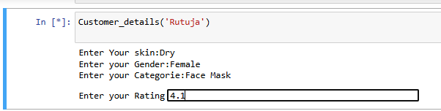
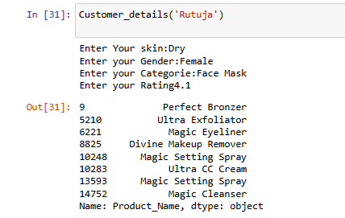
Recommendation Analysis

Slide 13
Conclusion
The data shows that key ingredients like Retinol and Glycerin boost customer satisfaction, and cruelty-free products receive higher ratings . Prices also vary based on skin type, such as oily or sensitive skin . To make customers happier, brands should offer more cruelty-free products, make sure they're creating items for different skin types, and set prices that match customer needs.

Slide 14
Recommendation
Products to Skin Types: Develop specific products for various skin types (e.g., oily, dry, sensitive) to better meet customer needs.
Offer Samples: Provide product samples, especially for new launches, to encourage customers to try before they buy.
Improve Packaging: Make packaging better by using materials that are good for the environment and easy to use. This will attract customers who care about the planet.
Gather Customer Feedback: Continuously collect and analyze customer feedback to improve product formulations and offerings.

